Slide 1

2. Probability and its uses

Slide 2
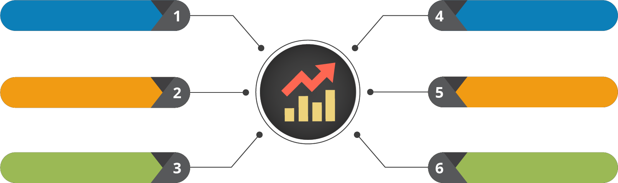
Course Outline
Understanding the Data
Testing the Data
Probability and its Uses
Data Clustering
Statistical Inference
Regression Modelling

Slide 3

Course Objectives
After completing this module, you should be able to:
Express the need and use of Probability
Demonstrate the use of Conditional, Joint and Marginal Probability
Express the Bayesian Inference
Explain the Probability Distribution and Density concepts
Demonstrate the use of Normal Distribution Curve

Slide 4


1. Introduction to Probability

Slide 5

Introduction to Probability

Slide 6


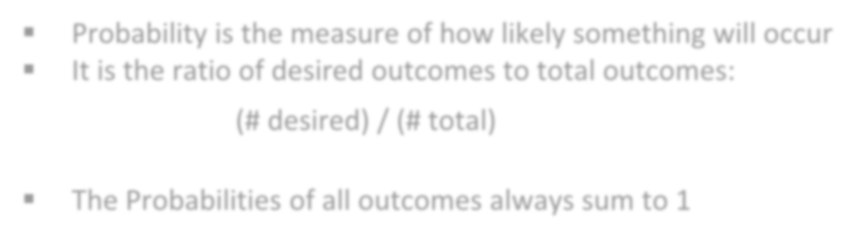
Probability
Probability is the measure of how likely something will occur
It is the ratio of desired outcomes to total outcomes:
(# desired) / (# total)
The Probabilities of all outcomes always sum to 1

Slide 7
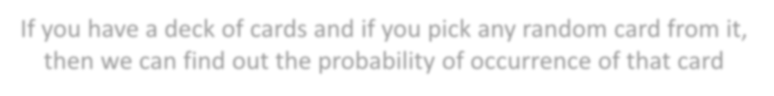




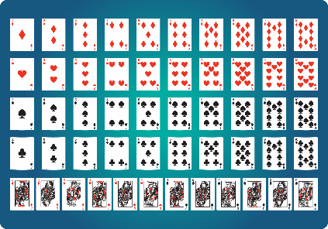



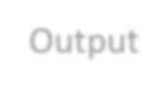


Example - Probability
If you have a deck of cards and if you pick any random card from it, then we can find out the probability of occurrence of that card
# Sample Space
cards = 52
# Outcomes
aces = 4
# Divide possible outcomes by the sample
set
ace_probability = aces / cards
# Print probability rounded to two decimal places
print(round(ace_probability, 2))
Output

Slide 8


Some of the Real Life Problems
Wish, if I could guess the occurrence of events
How to explore future opportunities?
How to be sure that a particular event will definitely place?

Slide 9


However, if you know the amount by which a certain event may occur, then you have a better chance of making more informed decision.

Slide 10
Terminologies of Probability

Slide 11
Terminologies of Probability
Random Experiment
An experiment or a process for which the outcome cannot be predicted with certainty
01
Sample Space
The entire possible set of outcomes of a random experiment is the sample space (S) of that experiment
02
Event
A set of outcomes of an experiment , it is a subset of S
03

Slide 12






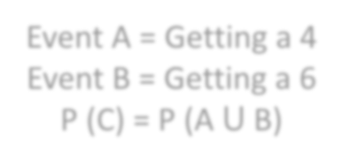
Union of Events
We can define an event (C) of getting a 4 or 6 when we roll a fair die. Here event C is a union of two events:
Event A = Getting a 4 Event B = Getting a 6 P (C) = P (A ꓴ B)

Slide 13


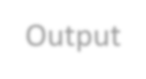





Example - Union of Events
#Union of events
dice=[1,2,3,4,5,6]
Output
4
6
n=len(dice)
for i in range(0,n):
if((dice[i]==4)or(dice[i]==6)): print(dice[i])

Slide 14





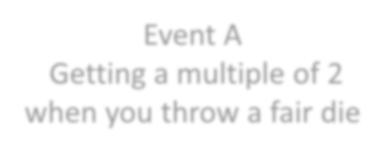
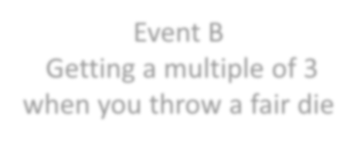
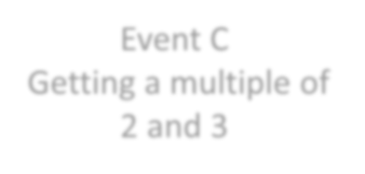



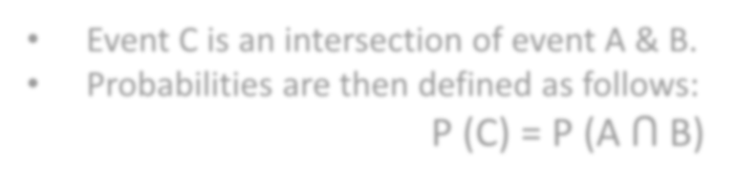

Intersection of Events
Let C be the event of getting a multiple of 2 and 3 when you throw a fair die
Event A
Getting a multiple of 2 when you throw a fair die
Event B
Getting a multiple of 3 when you throw a fair die
Event C
Getting a multiple of 2 and 3
Event C is an intersection of event A & B.
Probabilities are then defined as follows:
P (C) = P (A ꓵ B)

Slide 15








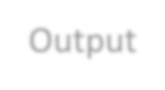



Example – Intersection of Events
dice=[1,2,3,4,5,6]
n=len(dice)
for i in range(0,n):
if((dice[i]%2==0)and(dice[i]%3)==0): print(dice[i])
Output
6

Slide 16
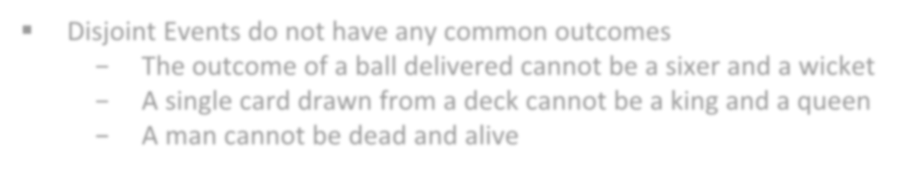


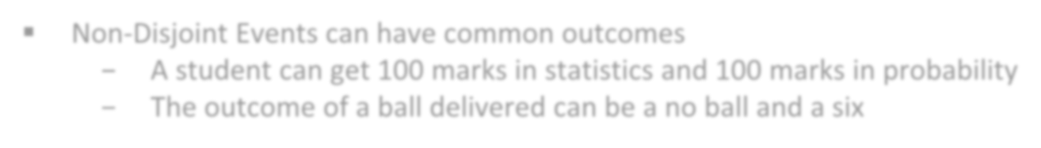
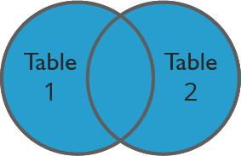
Types of Events
Disjoint Events do not have any common outcomes
The outcome of a ball delivered cannot be a sixer and a wicket
A single card drawn from a deck cannot be a king and a queen
A man cannot be dead and alive
Non-Disjoint Events can have common outcomes
A student can get 100 marks in statistics and 100 marks in probability
The outcome of a ball delivered can be a no ball and a six

Slide 17
Rules of Probability
For any Event A, P(A^{c}) = 1 - P(A)
If A ⊂ B, then P(A) ≤ P(B)
For any two Events A and B:
P(A ∪ B) = P(A) + P(B) - P(A ∩ B) (Addition rule)
When A and B are Disjoint, P(A and B) = 0, Hence P(A or B) = P(A) + P(B)
For three Events, A, B, and C :
P(A∪B∪C) = P(A) + P(B) + P(C) - P(A∩B) - P(A∩C) - P(B∩C) + P(A∩B ∩C)

Slide 18




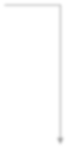



Independence
Two processes are independent if the occurrence of one does not affect the probability of the other
Outcomes of two balls (assume for simplicity 4 or 6 as the sample space) in a cricket match are Independent
1st Ball
2nd Ball
Product Rule for Independent Events: P(A and B) = P(A) x P(B)

Slide 19

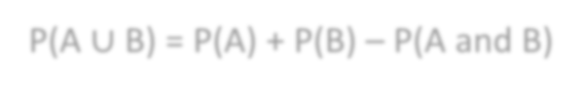
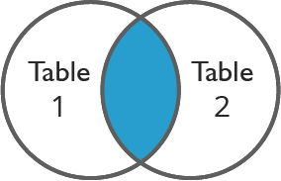
The General Addition Rule
P(A ∪ B) = P(A) + P(B) – P(A and B)
Note: When A and B are Disjoint, P(A and B) = 0, Hence P(A or B) = P(A) + P(B)

Slide 20

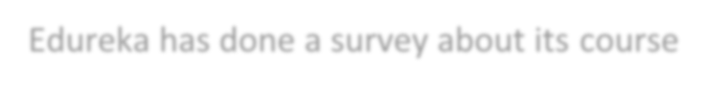







Use Case - Scenario
We have done a survey about its course
The most recent phase of the survey that polled 100,000 participants estimates that 80% of the population agree with the statement “The duration of the courses is just right”
The survey also estimates that 10% people have university degree, and that 5% of people fit both criteria
P(agree) = 0.80
P(University degree) = 0.1
P(agree and university degree) = 0.05

Slide 21
Use Case – Part 1
1. Event 1: Students agreeing with the statement “Duration of courses is just right”.
Event 2: 10% of the people having university degree. Check, if both the events are disjoint.
Solution:
P (agree) = 0.80
P (University degree) = 0.10
P (agree and university degree) = 0.05 ≠ 0
Not Disjoint
Since, the probability of agreeing with the statement “Duration of courses is just right” and having
a university degree is 0.05 which is not equal to 0. Hence, the events are Disjoint.

Slide 22


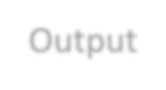

Use Case – Part 1 - Solution
#total number of participants
total=100000
#Probability of students agree that the duration of # the courses conducted by Edureka is just right agree=0.80
# probability of students having university degree
university_degree=0.1
#probability of students fit in both categories
agree_with_degree=0.05
#Part 1 solution
if(agree_with_degree==0):
print("Both events are disjoint") else:
print("Events are not disjoint")
Output

Slide 23

Use Case – Part 2
Draw a Venn diagram summarizing the variables and their associated probabilities:
P (agree) = 0.8
P (University degree) = 0.1
P (agree and university degree) = 0.05
Solution:
0.1
0.8
Agree
Uni. degree
0.75
0.05
0.05
0.8 – 0.05 = 0.75
0.1 – 0.05 = 0.05

Slide 24
Use Case – Part 3
What is a probability that a randomly drawn person has a university degree or agrees with the statement about duration time?
P (agree) = 0.8
P (University degree) = 0.1
P (agree and university degree) = 0.05

Slide 25




Use Case – Part 3 - Solution
General Addition Rule
Agree
Uni. degree
P(A ∪ B) = P(A) + P(B) – P(A and B)
P (agree or uni. degree) = 0.362
= P (agree) + P (uni. degree) – P (agree & uni. degree)
= 0.8 + 0.1 – 0.05
= 0.85
0.75
0.05
0.05
0.75 + 0.05 + 0.05 = 0.85

Slide 26


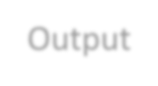
Use Case – Part 3 - Solution
#Probability that a randomly drawn person has a university degree #or agrees with the statement about duration time
soln=agree+university_degree-agree_with_degree
print("Probability that a randomly drawn person has a university
degree or agrees with the statement about duration time is ",soln)
Output

Slide 27
Use Case – Part 4
What percent of the population do not have a university degree and disagree with the statement about duration time of lectures?
P(agree) = 0.8 P(University degree) = 0.1
P(agree and university degree) = 0.05
P(agree or uni. degree) = 0.85
Solution:
P (neither agree nor uni. degree)
= 1 – P (agree or uni. degree)
= 1 – 0.85
= 0.15

Slide 28

Use Case – Part 4 - Solution
#percent of the population do not have a university degree
# and disagree with the statement about duration time of lectures
ans=1-soln
print("Percent of the population do not have a university degree "
"\n and disagree with the statement about duration time of lectures is ",ans)
Output

Slide 29
2. Probability Distribution

Slide 30
Probability Distribution

Slide 31




Probability Distribution
Probability Density Function
01
01
Probability Distribution Terminologies
02
Normal Distribution
02
03
Central Limit Theorem
03

Slide 32

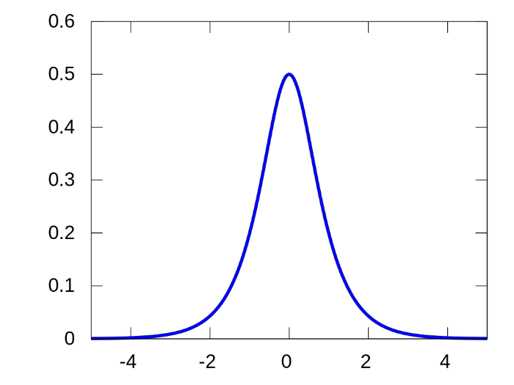
Probability Distribution Function
The Equation describing a continuous probability distribution is called as Probability Density Function

Slide 33
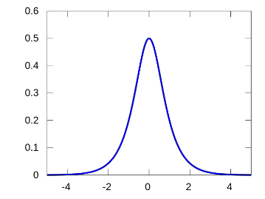

Probability Distribution Function
Property 01
roperty 02
roperty 03
The graph of a PDF will be
continuous over a range
P
Area bounded by the curve of the density function and the x-axis is equal to 1
P
The probability that a random variable assumes a value between a and b is equal to the area under the PDF bounded by a and b
Properties

Slide 34
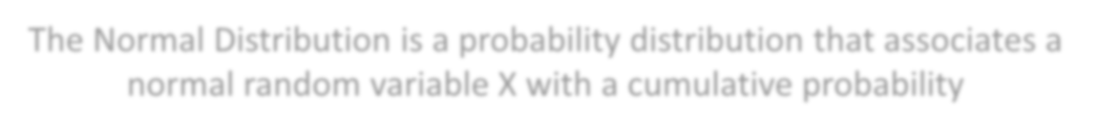

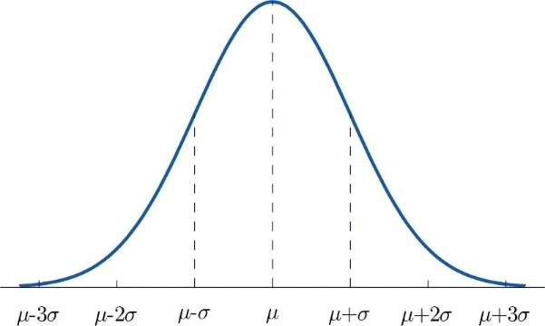

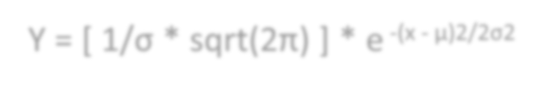



Normal Distribution
The Normal Distribution is a probability distribution that associates a normal random variable X with a cumulative probability
Y = [ 1/σ * sqrt(2π) ] * e ^{-(x - μ)2/2σ2}
Where,
X is a normal random variable
μ is the mean and
σ is the standard deviation
Note: Normal Random variable is variable with mean at 0 and variance equal to 1

Slide 35

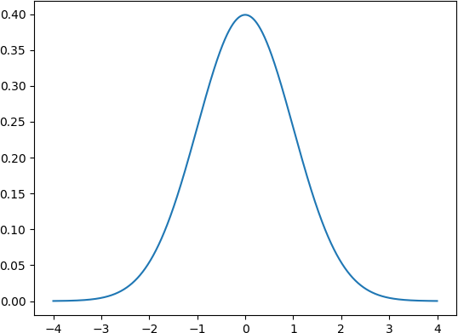

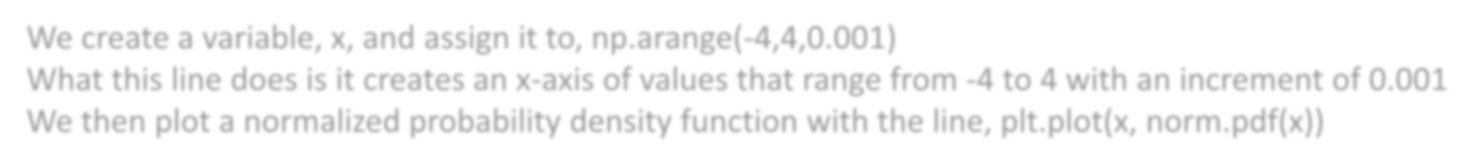

Example – Normal Distribution
from scipy.stats import norm
import numpy as np
import matplotlib.pyplot as plt
x= np.arange(-4,4,0.001)
plt.plot(x, norm.pdf(x))
plt.show()
We create a variable, x, and assign it to, np.arange(-4,4,0.001)
What this line does is it creates an x-axis of values that range from -4 to 4 with an increment of 0.001 We then plot a normalized probability density function with the line, plt.plot(x, norm.pdf(x))

Slide 36

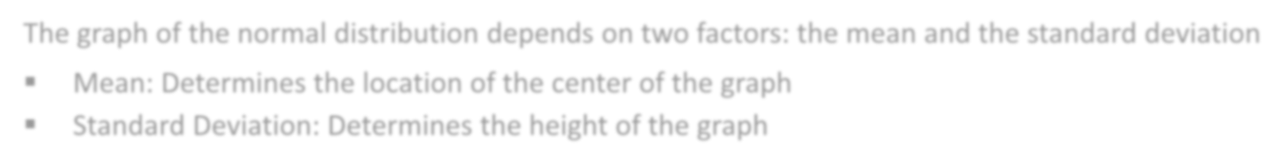
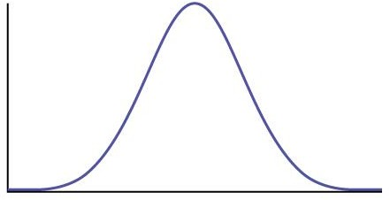
Standard Deviation and Curve
The graph of the normal distribution depends on two factors: the mean and the standard deviation
Mean: Determines the location of the center of the graph
Standard Deviation: Determines the height of the graph
If the standard deviation is large, the curve is short and wide.
If the standard deviation is small, the curve is tall and narrow.

Slide 37
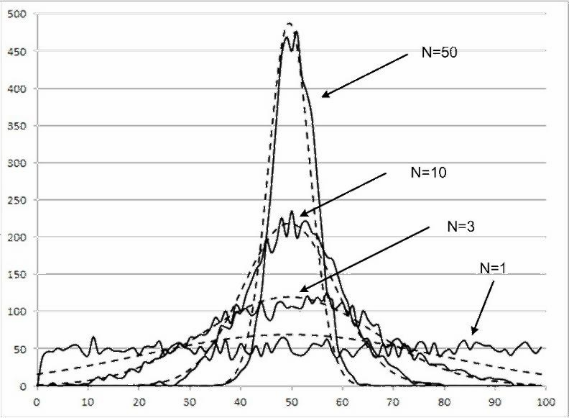
Central Limit Theorem
The Central Limit Theorem states that the sampling distribution of the mean of any independent, random variable will be normal or nearly normal, if the sample size is large enough

Slide 38
3. Types of Probability

Slide 39
Types of Probability

Slide 40
Types of Probability
Marginal Probability
01
02
Joint Probability
03
Conditional Probability

Slide 41


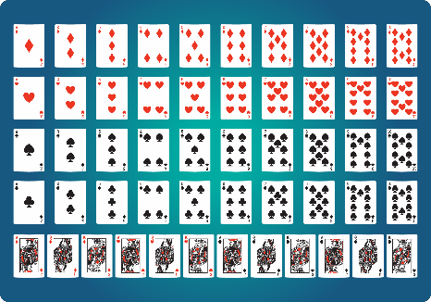
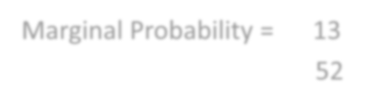



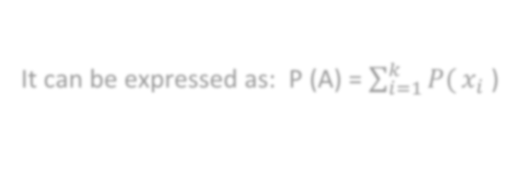

Marginal Probability
Marginal Probability is the probability of occurrence of a single event
Marginal Probability = 13
52
It can be expressed as: P (A) = σ^{𝑘}
𝑖=1
𝑃( 𝑥_{𝑖} )

Slide 42


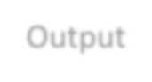
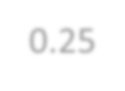

Example – Marginal Probability
# Sample Space
cards = 52
Output
# Determine the probability of drawing
a heart
hearts = 13
hearts_probability = hearts/cards
0.25
print(round(hearts_probability,2))

Slide 43

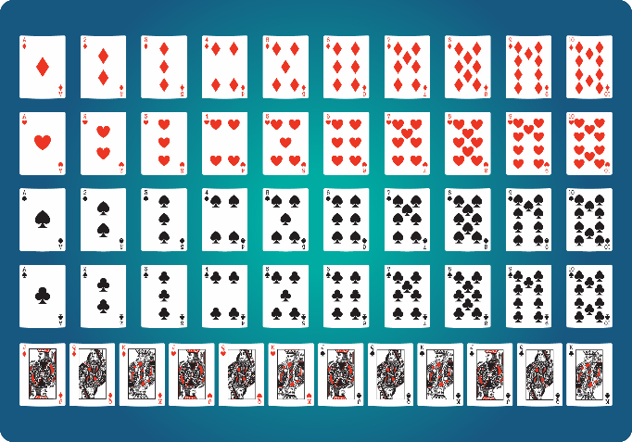


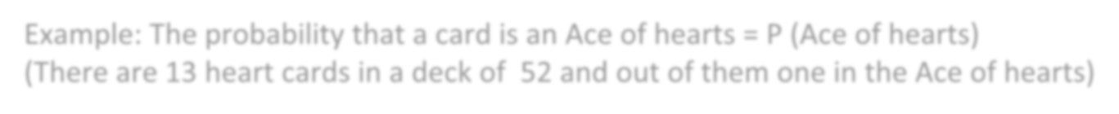
Joint Probability
Joint Probability is a measure of two events happening at the same time
Example: The probability that a card is an Ace of hearts = P (Ace of hearts)
(There are 13 heart cards in a deck of 52 and out of them one in the Ace of hearts)

Slide 44






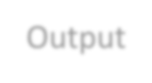
Example – Joint Probability
# Create function that returns probability percent rounded to one decimal place
def event_probability(event_outcomes, sample_space): probability = (event_outcomes / sample_space) * 100 return round(probability, 1)
# Sample Space
cards = 52
# Determine the probability of drawing a heart
hearts = 13
heart_probability = event_probability(hearts, cards) # Determine the probability of drawing a face card face_cards = 12
face_card_probability = event_probability(face_cards, cards) # Determine the probability of drawing the queen of hearts ace_of_hearts = 1
ace_of_hearts_probability = event_probability(ace_of_hearts, cards)
# Print each probability print(str(heart_probability) + '%') print(str(face_card_probability) + '%')
print(str(ace_of_hearts_probability) + _probability,2))
25 %
23.1 %
1.9 %
Output

Slide 45

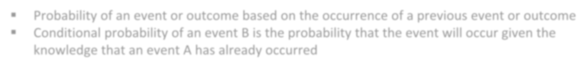




Conditional Probability
Probability of an event or outcome based on the occurrence of a previous event or outcome
Conditional probability of an event B is the probability that the event will occur given the knowledge that an event A has already occurred
If A and B are dependent events then the expression for conditional probability is given by :
P (B|A) = P (A and B) P (A)
If A and B are independent events then the expression for conditional probability is given by :
P(B|A) = P (B)

Slide 46


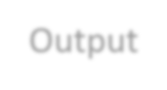

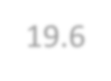
Example – Conditional Probability
# Sample Space
cards = 52
hole_cards = 2
turn_community_cards = 4
cards = cards - (hole_cards + turn_community_cards)
# Outcomes
diamonds = 13
diamonds_drawn = 4
# In poker, cards that complete a draw are known as "outs"
outs = diamonds - diamonds_drawn
#Determine river flush probability river_flush_probability = event_probability(outs, cards) print(river_flush_probability)
Output
19.6

Slide 47
4. Probability Use Cases

Slide 48
Probability Uses Cases

Slide 49




Use Case - Scenario
TRAINING STUDY
TRAINING AND SALARY PACKAGE OF CANDIDATES Study examining salary package and training undergone by candidates.
Sample: 60 candidates without training and 45 candidates with training.
Task to do: Assessment of training with salary package.

Slide 50
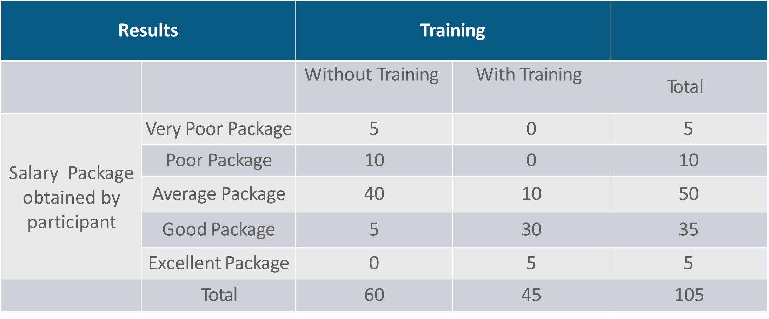
Use Case – Exploring the data

Slide 51
Marginal Probability – Problem Statement
Finding the probability that a candidate has undergone training

Slide 52
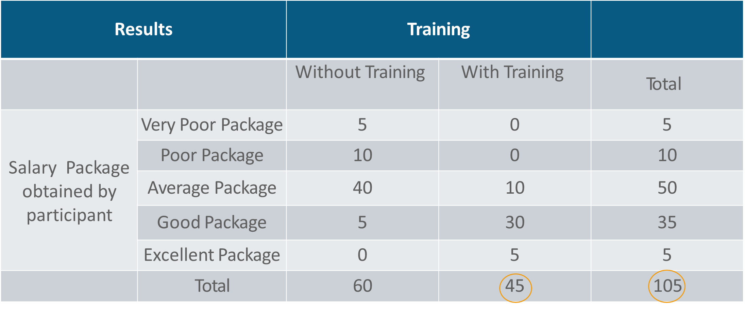
Marginal Probability - Solution
The probability that a candidate has undergone training
P(WithTraining ) = 45 /105 ≈ 0.42

Slide 53


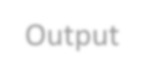
Marginal Probability - Solution
#Marginal Probability
#total number of students
total=105
#Students attended training
students_trained=45
# The probability that a candidate has undergone training
Withtraining=students_trained/total
print("The probability that a candidate has undergone training is ",round(edu_training,2))
Output

Slide 54
Joint Probability – Problem Statement
Finding the probability that a candidate has attended training and also has good package

Slide 55
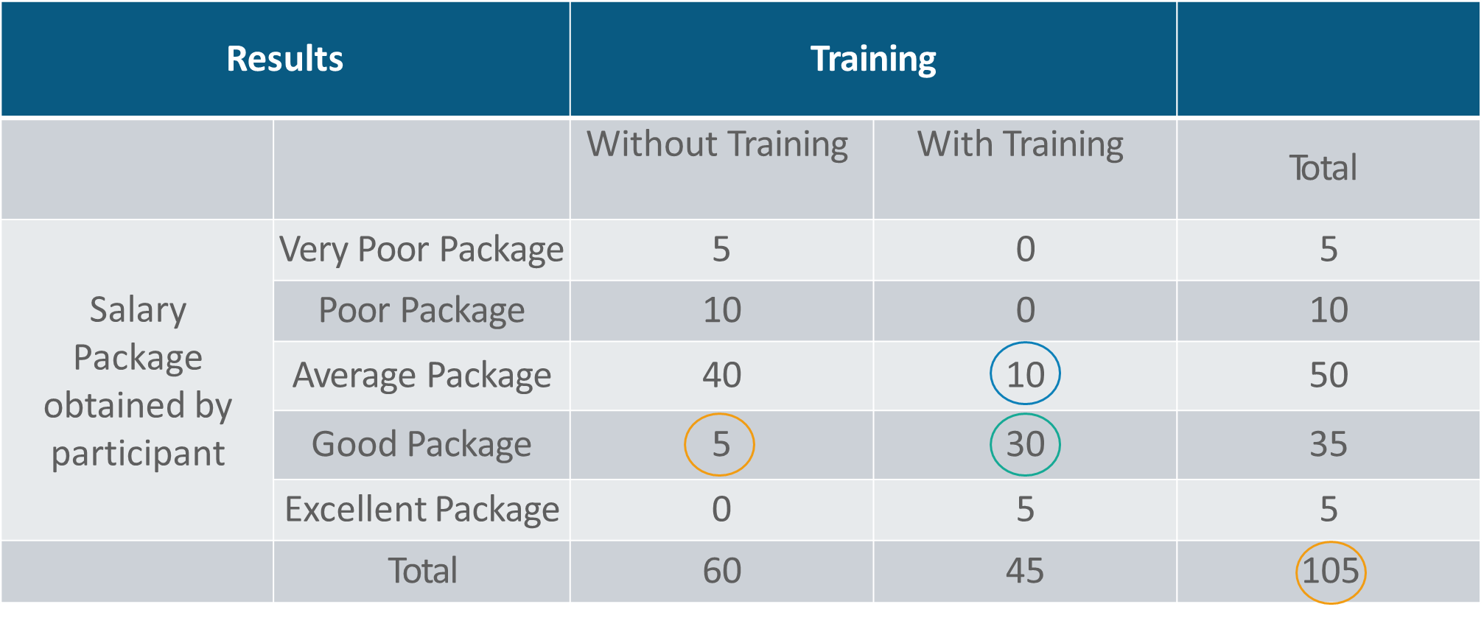
Joint Probability - Solution
Salary
Training
5
30
10
P (Good Package & Edu.Training ) = 30 /105 ≈ 0.28

Slide 56


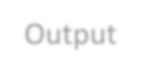
Joint Probability - Solution
#Marginal Probability
#students with training having good salary
good_sal_with training =30
#students without training having good salary
good_sal_without training=5
#Finding the probability that a candidate has attended With training and
# also has good package
student_good_sal=good_sal_ _with training /total
print("The probability that a candidate has attended training and also has good " "package ",student_good_sal)
Output

Slide 57
Conditional Probability – Problem Statement
Finding the probability that a candidate has a good package given that he has not undergone training
Results |  | Training
 |  | Without Training | With Training | Total
Salary Package obtained by participant | Very Poor Package | 5 | 0 | 5
 | Poor Package | 10 | 0 | 10
 | Average Package | 40 | 10 | 50
 | Good Package | 5 | 30 | 35
 | Excellent Package | 0 | 5 | 5
 | Total | 60 | 45 | 105

Slide 58
Conditional Probability - Solution
Results |  | Training
 |  | Without Training | With Training | Total
Salary Package obtained by participant | Very Poor Package | 5 | 0 | 5
 | Poor Package | 10 | 0 | 10
 | Average Package | 40 | 10 | 50
 | Good Package | 5 | 30 | 35
 | Excellent Package | 0 | 5 | 5
 | Total | 60 | 45 | 105
P (Good Package | Without Training) = 5 /60 ≈ 0.08

Slide 59


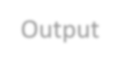
Conditional Probability - Solution
#Conditional Probability
#Total no. of students without edureka training
student_without_training=60
#Students getting good salary without training
student_without_training_good_sal=5
print("The probability of students getting good package without training " "is ",student_without_training_good_sal/student_without_training)
Output

Slide 60
5. Bayes' Inference

Slide 61
Bayes Inference

Slide 62
Baye’s Inference
Conditional Probability
Joint Probability
Baye’s
Inference
Marginal Probability

Slide 63








Baye’s Theorem
Shows the relation between one conditional probability and its inverse
P (B|A) is referred to as Likelihood Ratio which measures the probability (given event A) of occurrence of B
P (A) is referred to as Prior which represents the actual probability distribution of A
P (A|B) = P (B|A)
P (A)
P (B)
P (A|B) is referred to as Posterior which means the probability of occurrence of A given B

Slide 64


Baye’s Theorem and General Product Rule
Bayes’ theorem
_{P ( A | B) =} P ( A and B)
General product rule
P (A AND B) = P ( A | B) × P (B)
P (B)

Slide 65

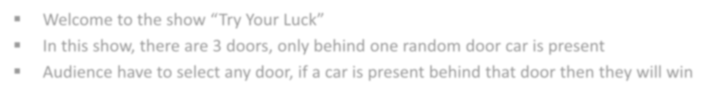









Example – Baye’s Theorem
Welcome to the show “Try Your Luck”
In this show, there are 3 doors, only behind one random door car is present
Audience have to select any door, if a car is present behind that door then they will win
[1, 2, 3]

Slide 66








Example – Baye’s Theorem
The Monty Hall Problem
But we want to design a program which will not allow the audience to win
Means, if the selected door is equal to the winning door, then the program will shuffle selected door with the remaining door
But what to do to design such program?
[1, 2, 3]

Slide 67


Example – Baye’s Theorem

Slide 68






Example – Baye’s Theorem
Steps to execute Monty Hall Problem
Step 1
Start the program. Allow the audience to select any random door from 1, 2 and 3
If Selected door=Winning door, then shuffle Selected door with remaining door, and tell the audience “Better Luck Next Time”
Step 2
Else if Selected door not equal to winning door, then print result as it is
Step 3
.
Step 4
Return the values and end the program

Slide 69

Flowchart
2
1
2
2
P(car@1|open2) =
(1/2 *1/3)
= 1/3
2
1
(1/2*1/3+0*1/3+1*1/3)
2
2
P(car@2|open2) =
(0*1/3)
= 0
(1/2*1/3+0*1/3+1*1/3)
2
3
P(car@3|open2) =
(1 *1/3)
= 2/3
(1/2*1/3+0*1/3+1*1/3)

Slide 70






Example – Baye’s Theorem
if switching_door==winning_door: switch=1
non_switch=0
else:
switch=0 non_switch=1
return(switch, non_switch)
month_hall()
Output

Slide 71

Summary
In this module, you should have learnt:
Need and use of Probability
Use of Conditional, Joint and Marginal Probability
Bayesian Inference
Probability distribution and density concepts
Use of Normal Distribution Curve

Slide 72


Congratulation
Probability & Statistics
for Data Science
You have successfully completed –
Probability and its uses Data Session

Slide 73




Next Topic, We will see the
Statistical Interference
Okay, I clearly understand the Probability and its uses
What Next?

Slide 74



Slide 75


Slide 76


Slide 77


